Slide 1



Internship
at Luminous Labs
Anindo Sarker
Reg. No. 2018831040

Slide 2

About Luminous Labs
Provides software development for Business Automation
Founded in Oct. 2016. Operates from Mirpur DOHS, Dhaka 25+ employees Works on Client Projects
2

Slide 3
Internship Activities
Feb
Mar
Apr
May
Jun
Jul
Learning Phase
Project Assignement Phase
Documentation Reading
Practise Projects
Assigned to the Beige projects
Understand BRS
Create an on demand videography and photography platform
3

Slide 4

Feb > Mar
Learning Phase
Documentation Reading
about the technologies related to upcoming projects
Next.js React Native Prisma MongoDB Google Maps AWS S3
4

Slide 5


Feb > Mar > Apr
Learning Phase
Practise Projects
Next.js blog with SSR, SSG
Attendance Management
Web embedded pos app
Uber Clone
5

Slide 6
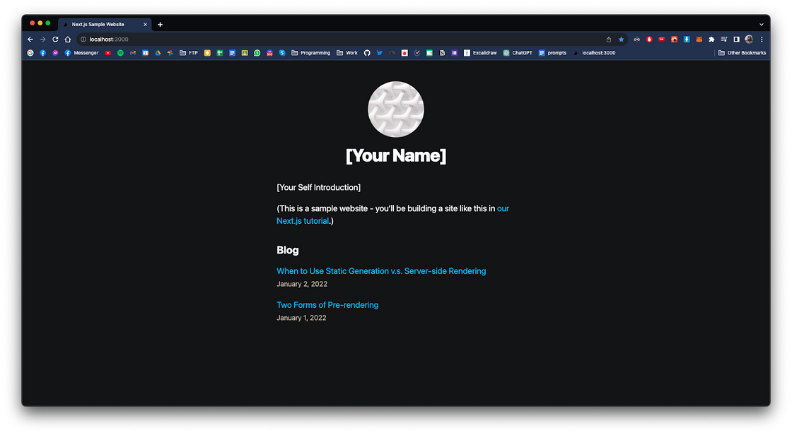
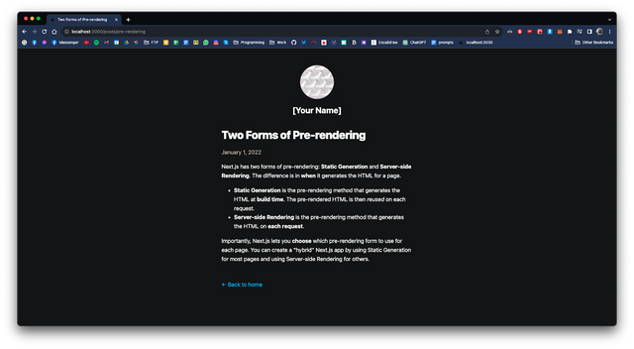
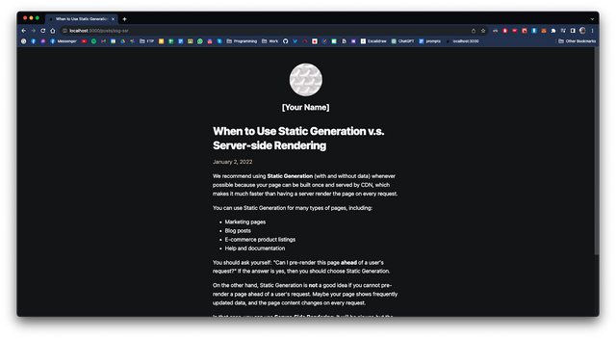
Feb
Learning Phase
Next.js blog with SSR, SSG
Platform: Web
Tech Stack: Next.js, Supabase
Target of this project was to learn:
CRUD functionality
Server Side Rendering (SSR)
Static Site Generation (SSG)
6

Slide 7
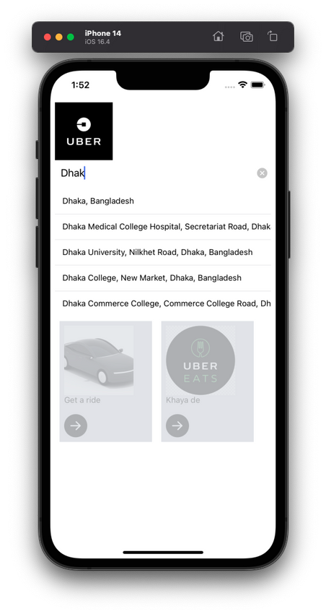
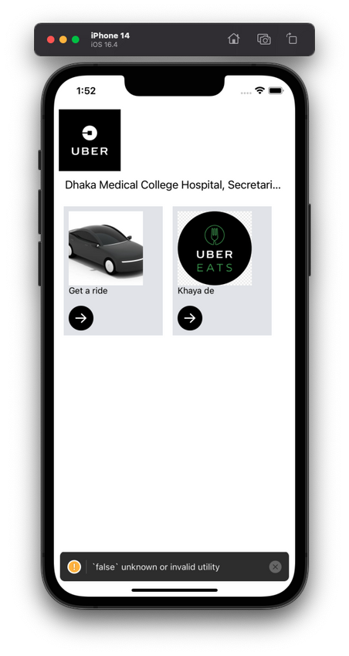
Feb > Mar > Apr
Learning Phase
Uber Clone
Platform: iOS
Tech Stack: React Native, Expo, Redux Toolkit, Google Maps Api
Target of this project:
Learn how to display maps in React Native applications
Learn how to use Google maps apis (Places api and Directions api)
7

Slide 8
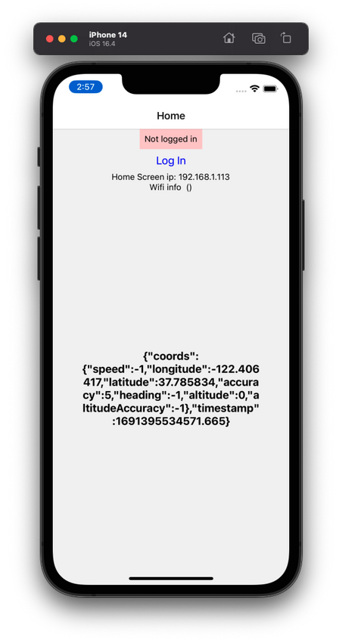
Feb > Mar
Learning Phase
Attendance Management
Platform: iOS
Tech Stack: React Native, Expo
Target of this project was to learn:
How to use phones biometric apis
How to use location services of iPhone and Android
8

Slide 9
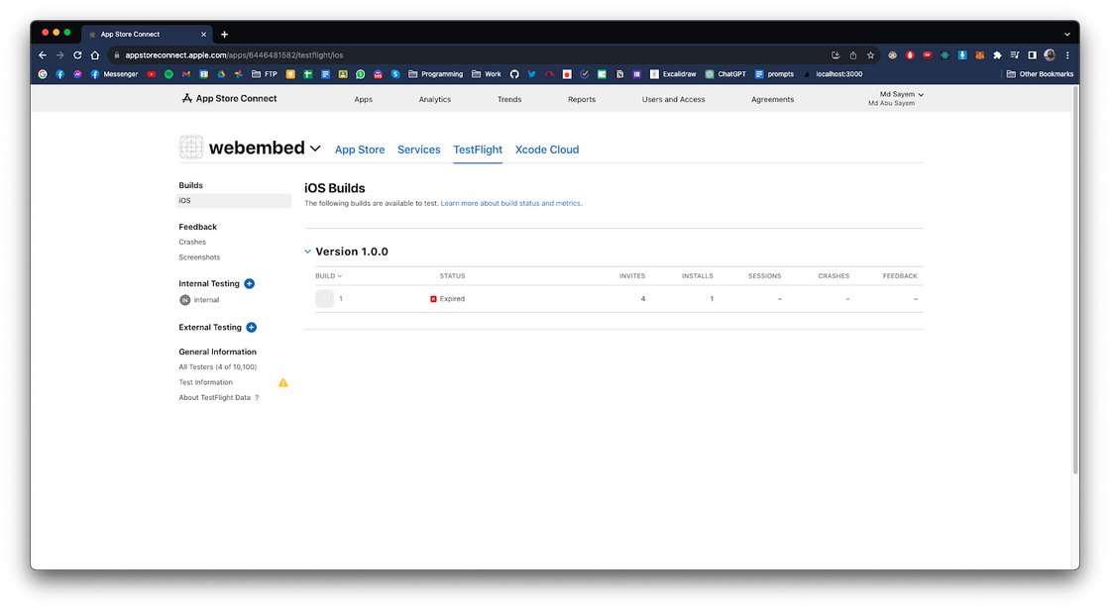
Feb > Mar
Learning Phase
Web embedded pos app
Platform: iOS
Tech Stack: React Native, Expo
The main goal of this project was to learn how to deploy this application to Apple TestFlight.
9

Slide 10
Feb > Mar > Apr > May > Jun > Jul
01
Goal
To create an on demand Videography and Photography services platform
Project Assignement Phase
02
Task
Create iOS apps and necessary software architecture
Assigned to the Beige Projects
03
Projects
Beige Client App
Beige CP App
Beige Backend
10

Slide 11


Feb > Mar > Apr > May > Jun > Jul
Project Assignement Phase
Beige Projects
on-demand videography and photography services platform
Beige Client App | Beige CP App | Beige Backend
React Native Expo Tailwind | React Native Expo Tailwind | Node.js Express MongoDB
11

Slide 12
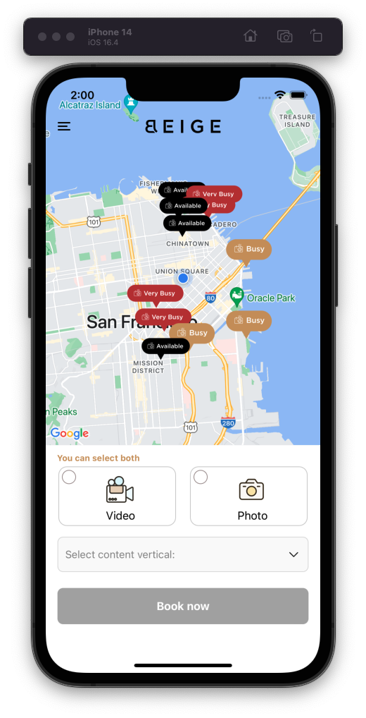
Feb > Mar > Apr > May > Jun > Jul
Project Assignement Phase
Beige Client App
Platform: iOS
Tech Stack: React Native, TypeScript, Expo, Google Maps api
Beige Client App is an iOS app like Uber. Users can request for photography/videography services
What I did:
Implement UI designs with React Native according to Figma designs
Implement Google Maps
Add chat functionality with Socket.io
Deploy app to Apple Testflight
12

Slide 13

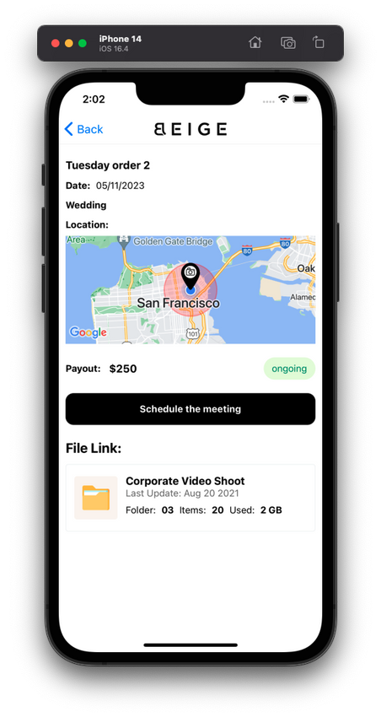
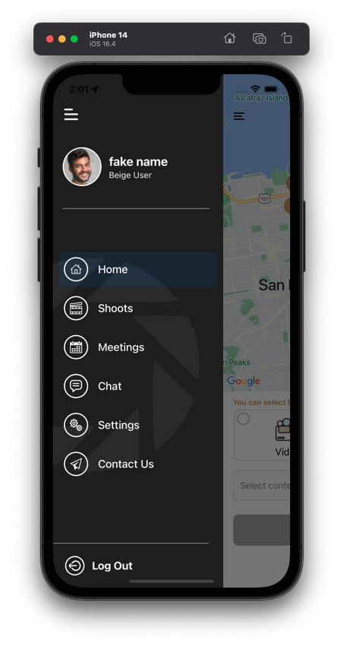
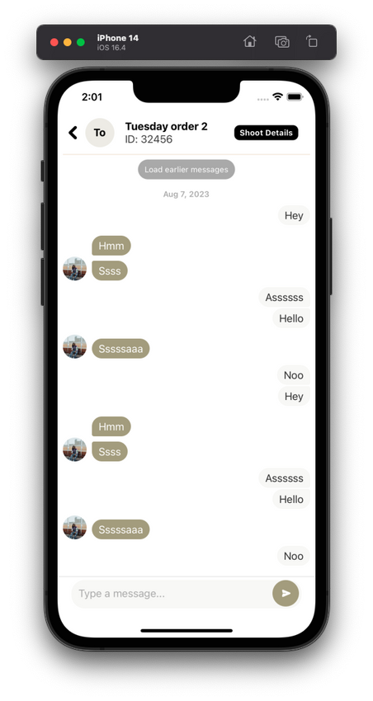
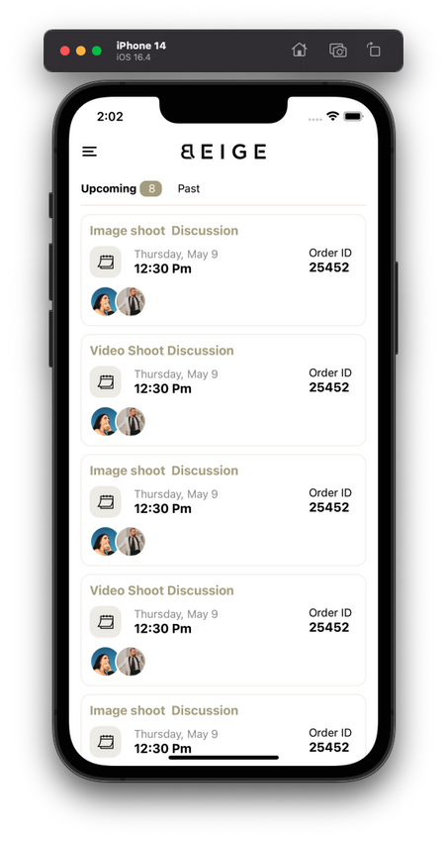
Feb > Mar > Apr > May > Jun > Jul
Project Assignement Phase
Fig: Beige Client App
13

Slide 14
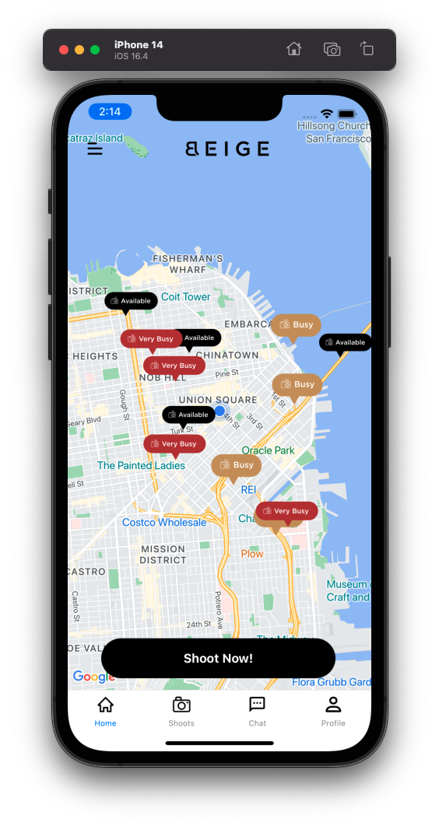
Feb > Mar > Apr > May > Jun > Jul
Project Assignement Phase
Beige CP App
Platform: iOS
Tech Stack: React Native, TypeScript, Expo, Google Maps api
Beige CP App is like the Uber driver app. Content producers can register and provide their photography/videography services
What I did:
Implement UI designs with React Native according to Figma designs
Implement Google Maps
Add chat functionality with Socket.io
Implement file upload system with AWS S3
Deploy app to Apple Testflight
14

Slide 15

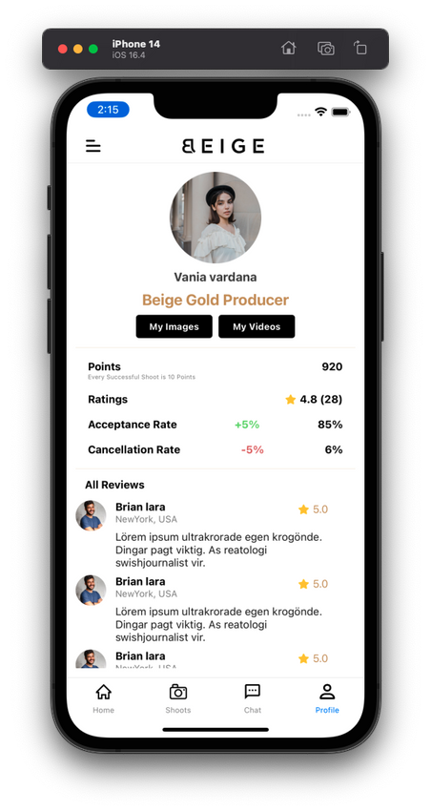
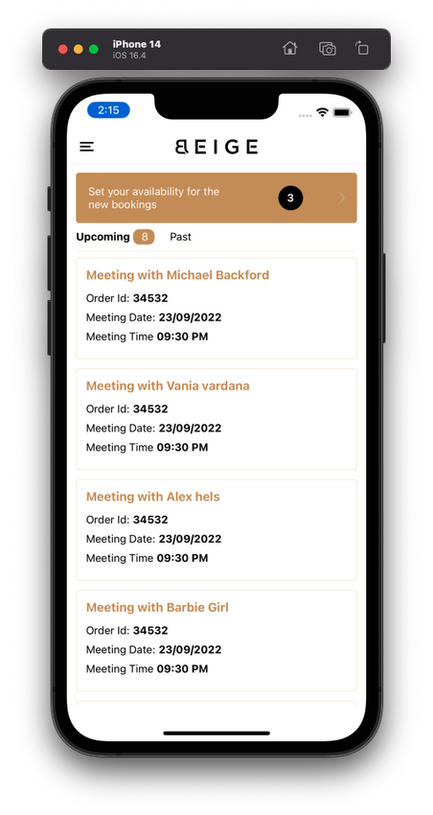
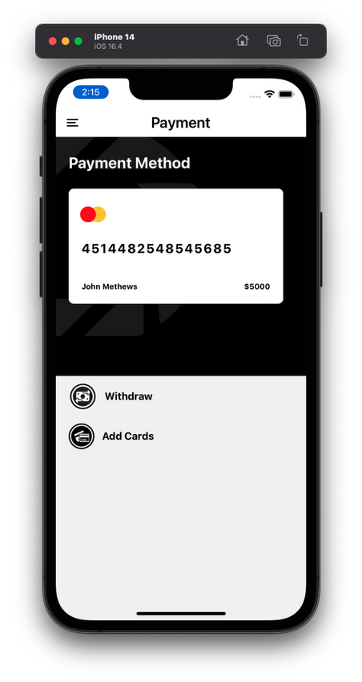
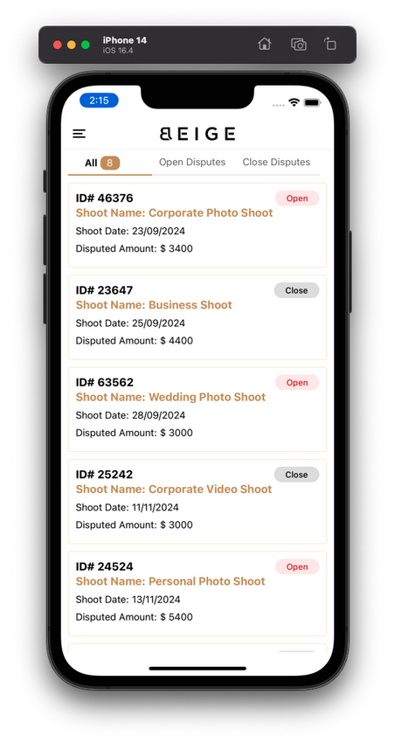
Feb > Mar > Apr > May > Jun > Jul
Project Assignement Phase
Fig: Beige CP App
15

Slide 16
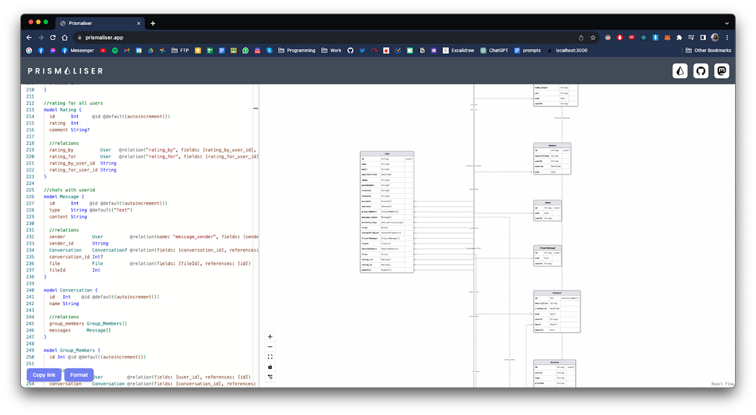
Beige Backend (Next.js)
Platform: Web
Tech Stack: Next.js, MySQL, Prisma
Target of this project:
Understand the BRS
Design the database accordingly
Use it as a backend for iOS apps and Web
Use it as web frontend
This project is replaced with the project discussed next.
16

Slide 17
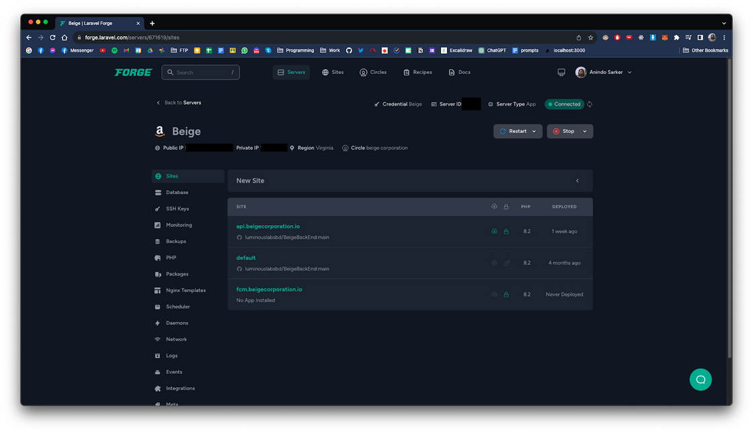
Beige Backend (Ongoing)
Platform: Web, iOS, Android
Tech Stack: Node.js, Express, MongoDB
Services: Google Maps api, Stripe, AWS S3, FCM, Forge
This project acts as the backend of the entire infrastructure
What I did:
Designed the database models
Implemented Role Based Access Control
Created api endpoints for all the different modules and services
Created AWS S3 storage upload, download stream functionality
Implemented push notification backend with Google Firebase Cloud Messaging (FCM)
Create payment gateway using Stripe
Add chat functionality with Socket.io
17

Slide 18

Challenges
Some notable challenges I faced:
Deploying Apps to Apple Testflight
Database Design
MongoDB Aggregation
React Native Stack Navigator Design
AWS S3 upload architecture for large files(>500 MB)
Stripe Payment system
Socket.io chat room management
Understanding Client demands
18

Slide 19

Conclusion
By the end of internship, I got: Remote Job offering Project manager role
19

Slide 20

Complete Timeline
Jul
Jun
May
Job Offering
Apr
Team Management
Remote Job offer
Ongoing projects:
Beige Backend
Beige Client app
Beige CP app
Mar
Project Assignment
Beige Backend (Express)
Beige Client app (React Native CLI)
Beige CP app (React Native CLI)
Feb
Project Assignment
Backend deployment
Beige Backend (Express)
Server management
Beige Client app ( Expo)
Beige CP app (Expo)
Learning
Beige Backend (Next.js)
Uber Clone (React Native, Expo)
Beige Client app ( Expo)
Beige CP app (Expo)
Learning
Assigned with Beige project
Web embedded pos app
Database design Beige Backend (Next.js)
Pos React Native
Documentation reading a learning
Next.js blog
Attendance Management
20

Slide 21

Do you have any questions?
Feel free to ask :)
21

Slide 22

Thank you!

